Slide 1

CBS Chatbot
Jan, Askin, Şeyma, Timo

Slide 2
Goal
The goal of our research is to categorize the top 10 most asked topics/questions that are asked by e-mail to CBS

Slide 3
Table of contents
Findings
Upcoming Week

Slide 4
Findings
Finishing Up
Results
02
Report
01
Final Results

Slide 5
Report
Results
Discussion
Conclusion

Slide 6
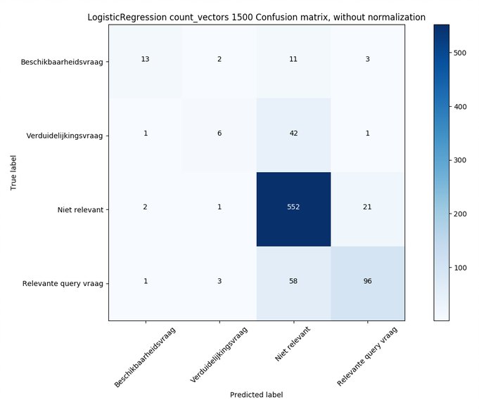
Results
Logistic Regression Count Vectors 1500 confusion matrix w/o norm

Slide 7
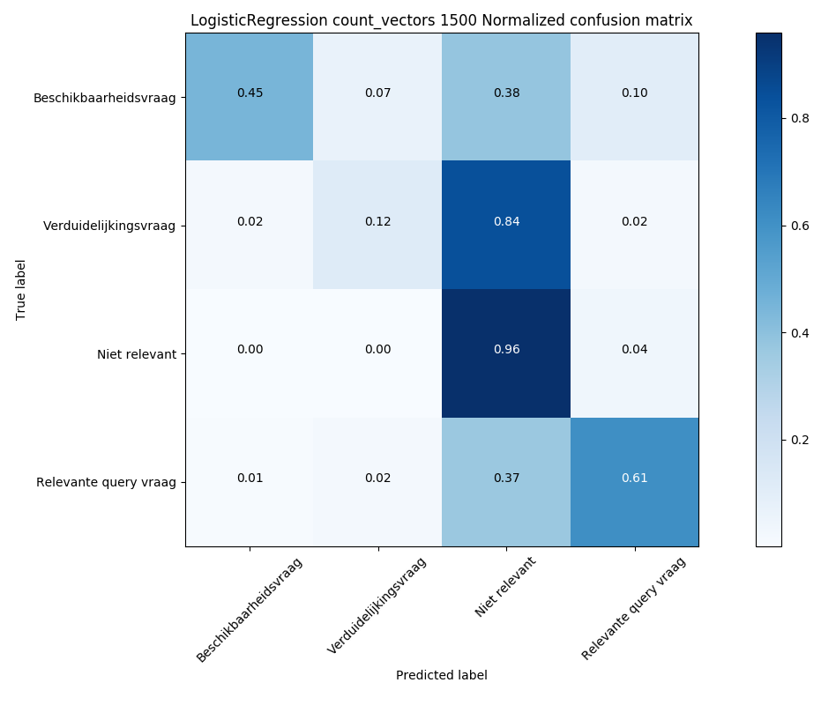
Results
Logistic Regression Count Vectors 1500 confusion matrix w/ norm

Slide 8
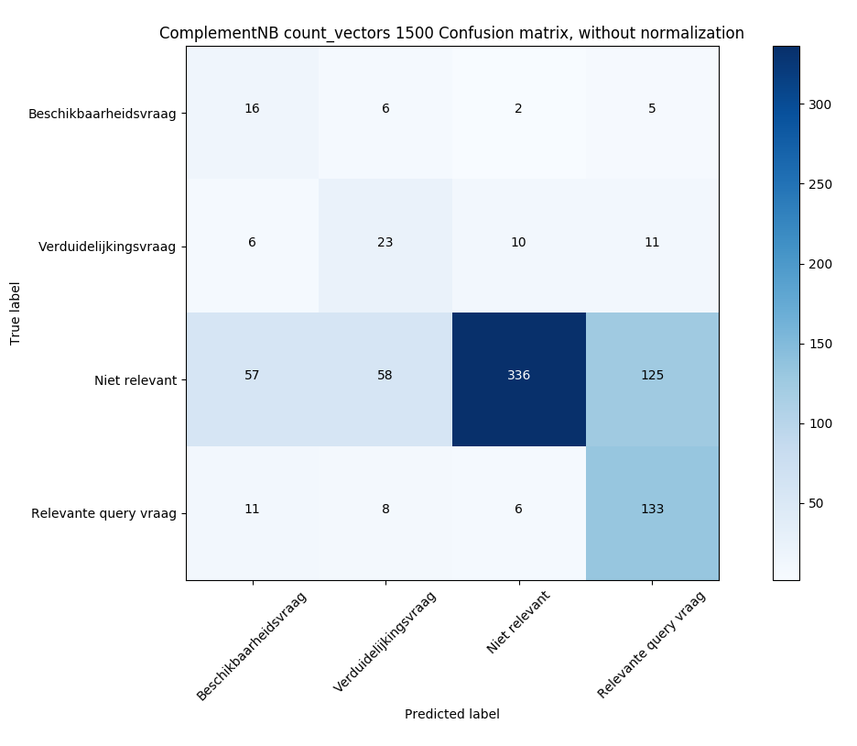
Results
Complement Naïve Bayes count vectors 1500 confusion matrix w/o norm

Slide 9
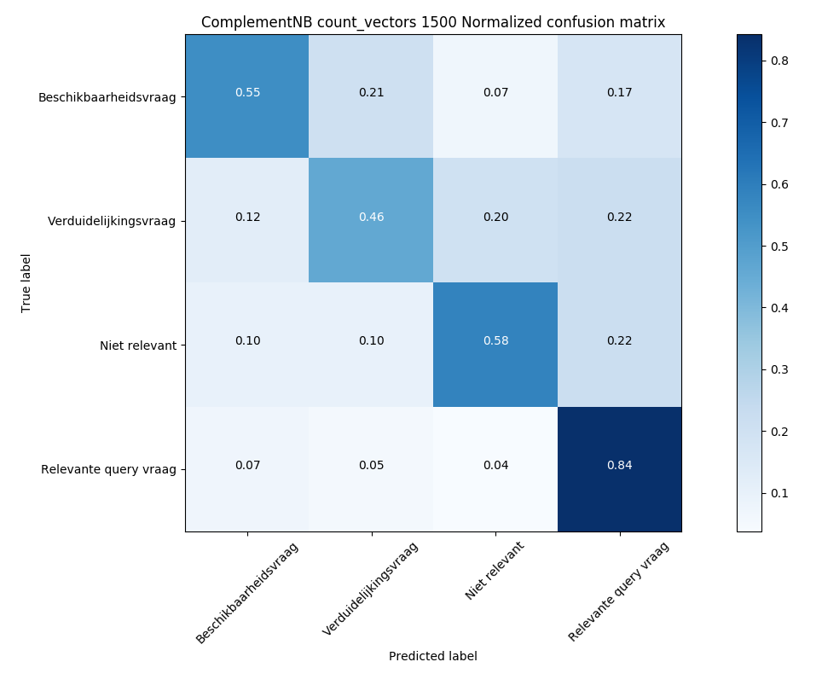
Results
Complement Naïve Bayes count vectors 1500 confusion matrix w norm

Slide 10
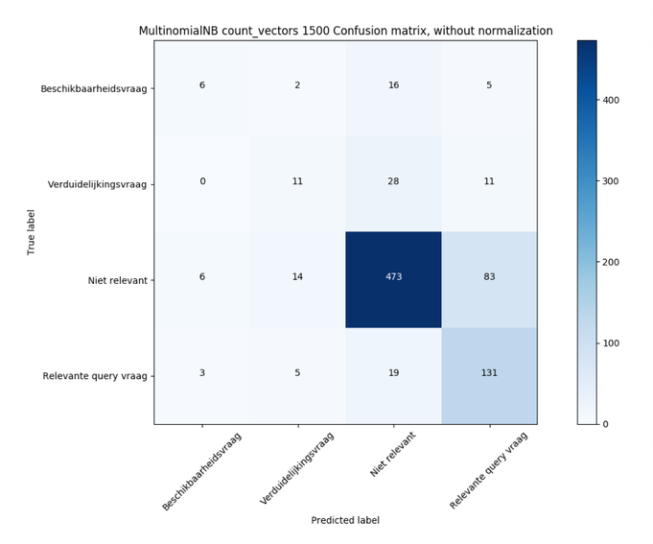
Results
Multinominal Naïve Bayes count vectors 1500 confusion matrix w/o norm

Slide 11
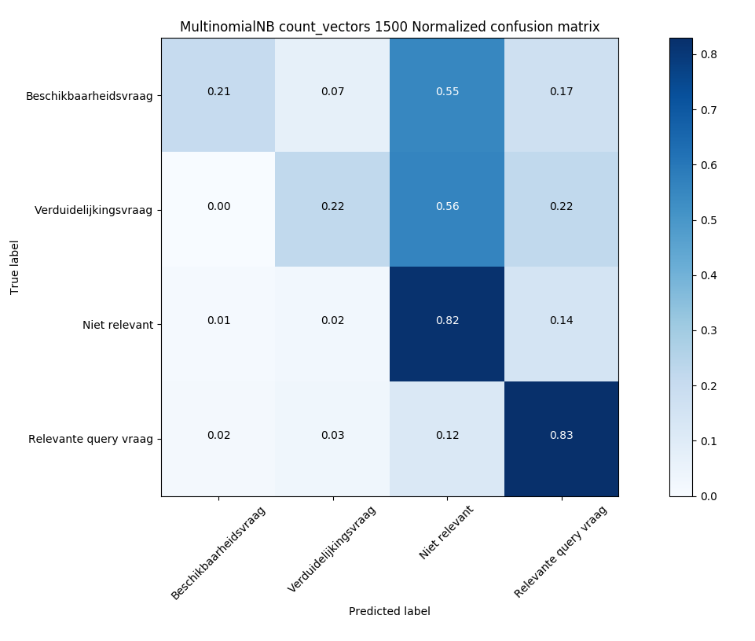
Results
Multinominal Naïve Bayes count vectors 1500 confusion matrix w/ norm

Slide 12
Upcoming Week
Finishing touches for the Research paper
01
Visualizing the results
02
Research Topic Analysis
03
Less or More Noise

Slide 13

Questions or feedback?

